Slide 1
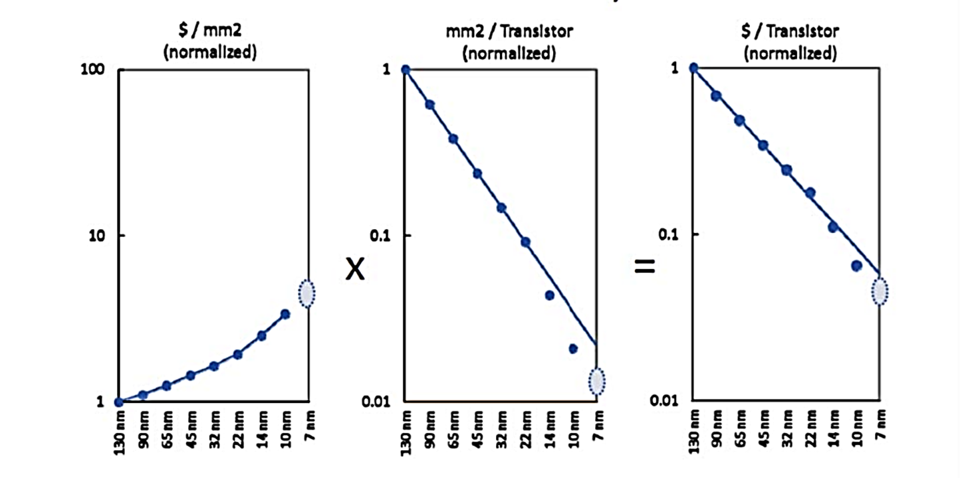
Lecture 7
Chemical Engineering for Micro/Nano Fabrication

Slide 2
Optical Lithography Limits
R = minimum feature size, λ = wavelength n = refractive index, θ = capture angle of lens
n = 1.44 (Water)
k₁ = 0.3
λ = 193 nm
sinθ = 0.9
R = 45

Slide 3
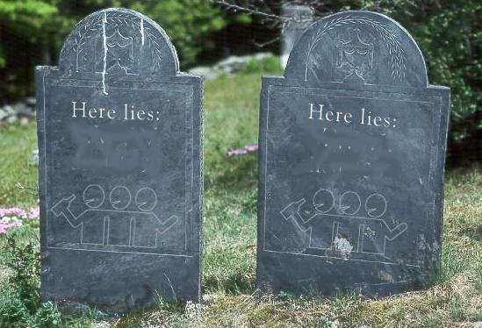
The Landscape is littered with NGL’s
Electron Beam direct write
Write with many electron beams
Project electron beams
157nm Photolithography
Shadow printing with Synchrotron X-rays
157nm
X-ray
X-ray
157nm

Slide 4

Is this the end…of Moore’s Law??
This cannot be!!!
It would lead to economic collapse

Slide 5


Slide 6



Applying enough money and brains has always solved our problems
Can’t bridge the gap!!!?? ☹
Intel Plows $4.1 billion Into Next-Gen Chip Production
MITI
SEMATECH
DARPA
TSMC eyes future technology with $1.4 billion …. Investment
Artist: Bruce Marion

Slide 7
Extreme ultraviolet lithography:
overview and development status
Peter J. Silverman
Intel Corporation
Santa Clara, California 95054
J. Microlith., Microfab., Microsyst. 4(1), 011006 (Jan–Mar 2005)

Slide 8
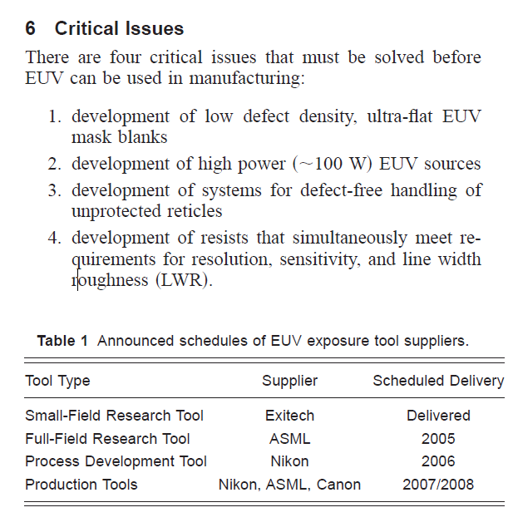
EUVL “Critical Issues”

Slide 9
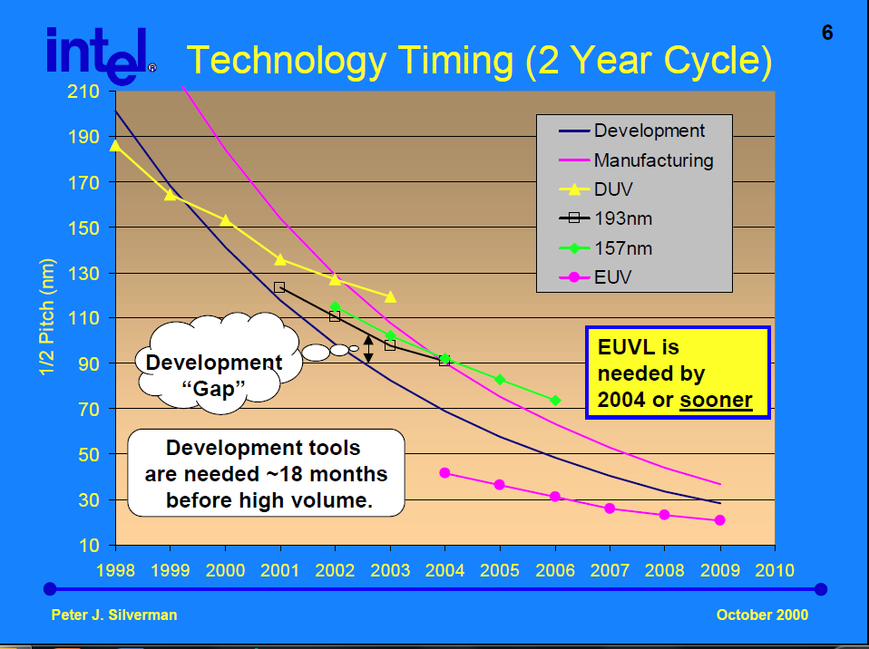

Slide 10
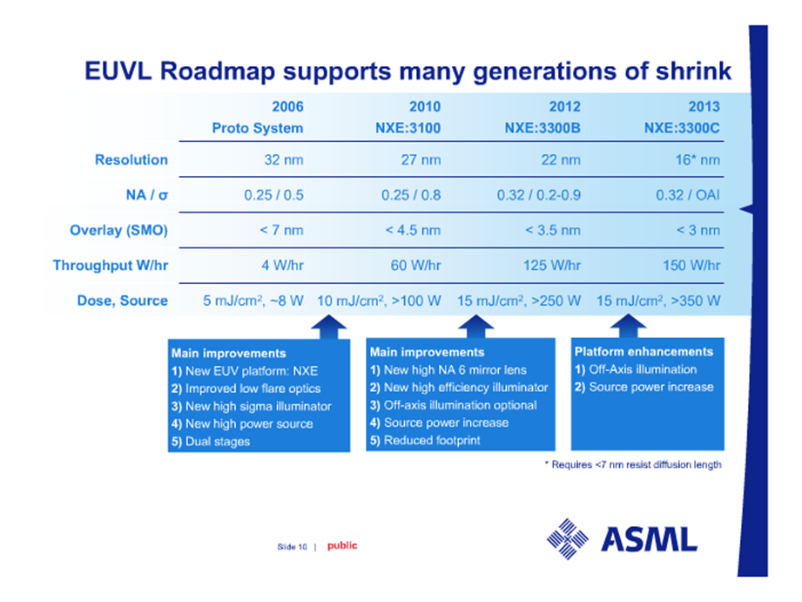
HOPE

Slide 11
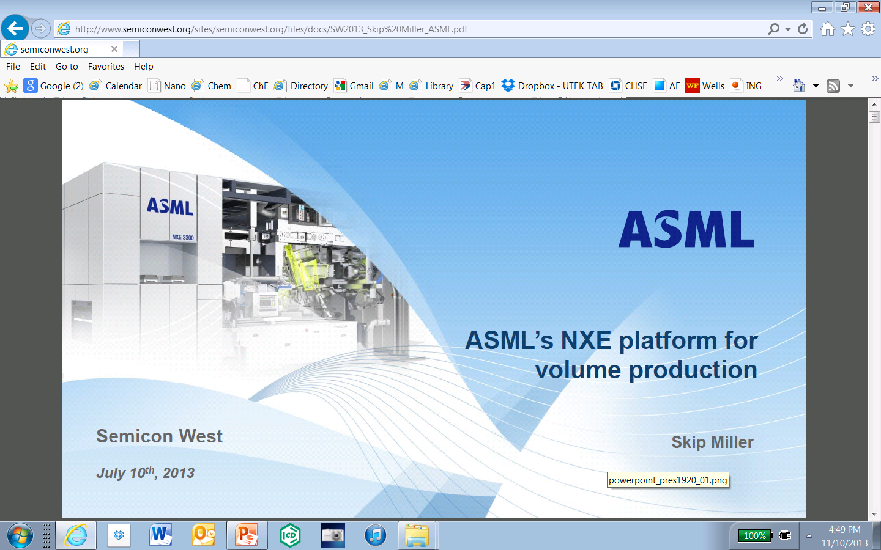

Slide 12
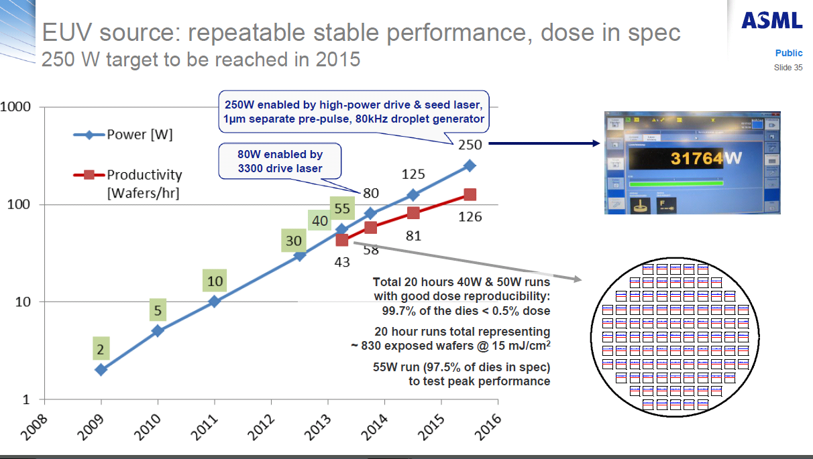
Gap?

Slide 13
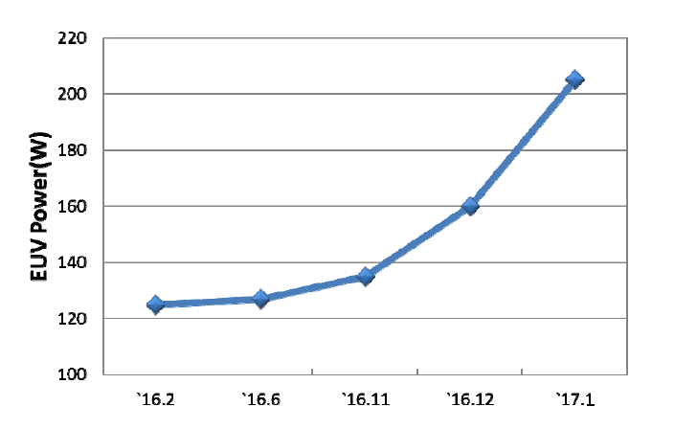
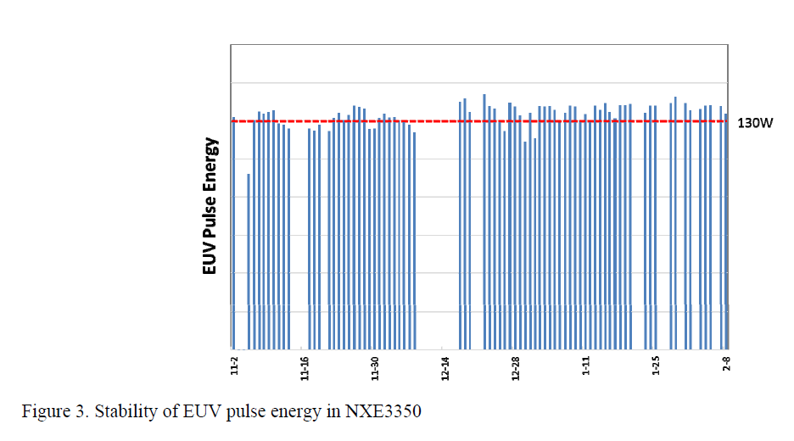
2017 EUV Brightness data
Proc. of SPIE Vol. 10143 1014306-1

Slide 14
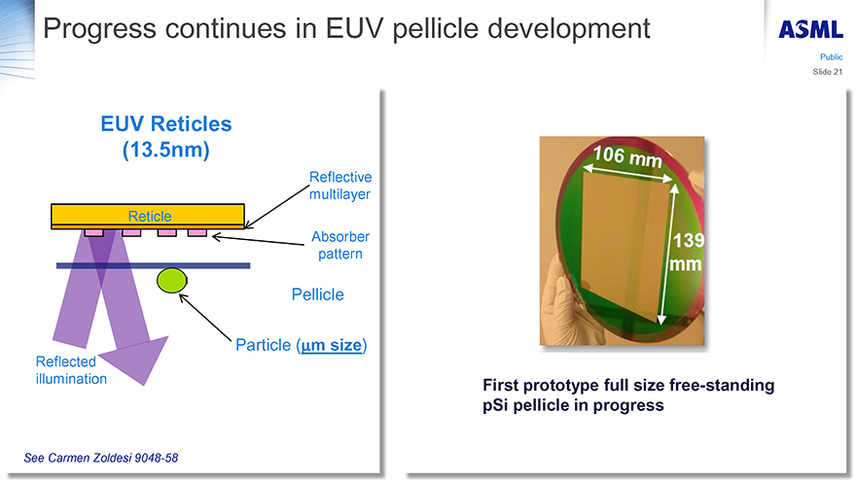
Absorbance now between 10 and 20%

Slide 15
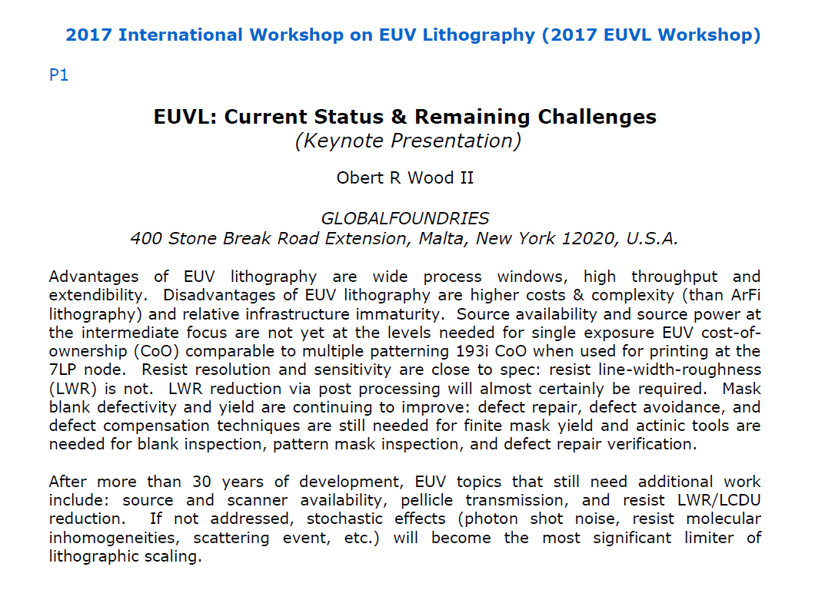

Slide 16
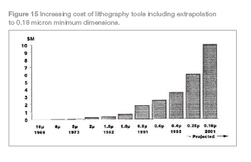
1995 Predictions by Gordon Moore

Slide 17
1995 Predictions by Gordon Moore

Slide 18
Exposure Tool Price versus Time
Last Published cost was 2010 …$120M
Various Manufacturers
$100,000,000
 E U V ?
Includes historical data for both steppers and scanners of all
157nm ?
makes and models from various manufacturers including
ASET, ASML, Cameca Instruments, Censor AG, Canon, Eaton,
193nm steppers
GCA, General Signal, Hitachi, Nikon, Perkin-Elmer, SVGL,
and Ultratech.
$10,000,000
Tool Price ($)
$1,000,000
$100,000
1975
1980
1985
1990
1995
2000
2005
2010

Slide 19
EUV tool costs hit $120 million
Mark LaPedus
11/19/2010 6:55 PM EST
SAN JOSE, Calif. - Who can afford extreme ultraviolet (EUV) lithography?
Answer: Very few companies. And the tool price tag is going up. ''EUVL: and the price is? The answer is...$125 million'' per tool, said G. Dan Hutcheson, CEO of VLSI Research Inc., in a report. ''Don’t choke. Years ago, (Risto Puhakka, president of VLSI Research) predicted this with a cost-per-pixel analysis. Everyone thought he was insane at the time…

Slide 20
Exposure Tool Price versus Time
$200,000,000
$100,000,000
$10,000,000
Tool Price ($)
$1,000,000
1990
1995
2000
2005
2010
2017

Slide 21
High Cost of Ownership
EUV uses ca 13,000 KwH/day
Requires > 500,000 gallons of cooling H₂0 / day
1 KwH represent, for example, the power required to operate a 100 w light bulb for 10 Hours.
A typical house consumes ca 850 KwH / MONTH
There are several assessments of COO for EUV available in the literature….caution…carefully review the assumptions
If you consider depreciation of the capital cost…the COO numbers are VERY high.

Slide 22
Rising Cost of Wafer Fabs Vs. GNPs
100 nm
70 nm
50 nm
35 nm
technology
technology
technology
technology
GNP of:
node, 2004
node, 2007
node, 2010
node, 2013
1000
Denmark
Singapore
100
Hungary
Czech Rep.
Luxemburg
billion $
Guatemala
10
Panama
?
Kenya
1
Macedonia
Monaco
0.1
0.01
10
1
0.1
0.01
feature size [µm]
Ralph Dammel SPIE 2002
®

Slide 23
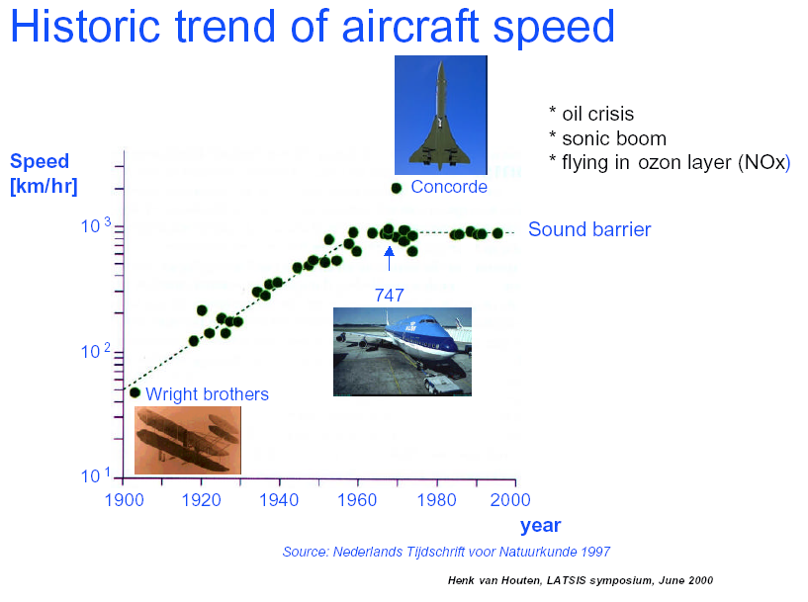

Slide 24
Lithography expert Christopher Mack wrote about ASML’s EUV presentation at the 34th International Conference of Photopolymer Science and Technology in early July. When asked when its equipment would be ready for manufacturing insertion, ASML claimed second half of 2018. Mack writes:
I laughed out loud when I heard that. When I asked if that prediction was serious, the response was “it depends on how you define manufacturing.”

Slide 25
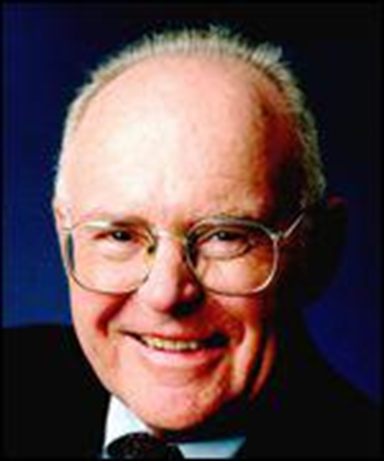
Gordon Moore, Lithography and the Future of Moore's Law [Proc. SPIE Vol. 2437, May 1995]

Slide 26


Don’t worry EUV will work….
in the end
and if it’s not ok….. it’s not the end!

Slide 27





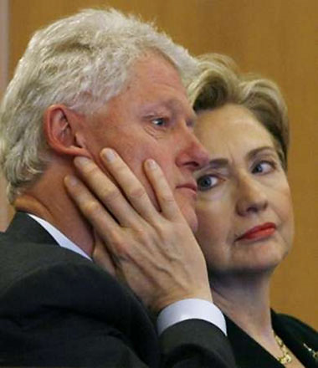


Oh No..what do we do now????

Slide 28
So…we keep “tweeking” 193 immersion
Wave Front Engineering
  SRAFS (Sub resolution assist features)
  OPC (optical Proximity Correction)
  RET (Reticle Enhancement Techniques)
  Phase Shifting masks
    Of Various Designs.
  Inverse Lithography Processes
Trying to survive until we are saved by an NGL (Next Generation Lithography)
  Ion Beam
  Imprint in various Forms
  E-Beam Lithography – Multi Beam. Projection, etc.
    MAPEL, REBL, Scalpel, Mapper, Etc.
  Etc, Etc, Etc..

Slide 29
Wavefront Engineering: OPC
Optical and Process Correction (OPC)
for Amplitude Control
Rule-Based OPC - modifies layout with sub-resolution assist features to compensate for process distortions
  Add light where needed
  Subtract light where not wanted
  Add structures to layout to control diffraction of light
Lithography equipment does not form images of these features
Scatter outside the lens NA
Employs MANY engineers
Notes:
OPC applies systemmatic changes to photomask geometries to compensate for nonlinear distortions caused by optical diffraction and resist process effects. These distortions include linewidth variations dependent on pattern density, which affect device operating speed, and line end shortening which can break connections to contacts.
To compensate for line end shortening, the line is extended using a hammer head shape that produces a line much closer to the intended shape. To compensate for corner rounding, serif shapes are added to or subtracted from corners to produce more accurate angles. Determining the optimim type, size and symmentry or lack thereof is complex and depends on neighboring geometries and process parameters.

Slide 30
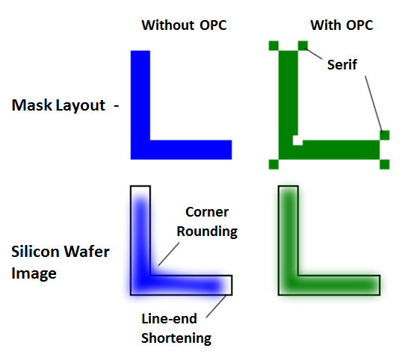
Optical Proximity Correction SRAFs

Slide 31
Impact of OPC on Physical Design
Design
Layout
Mask
Serifs
Scatter Bars
Final
Layout
Wafer

Slide 32
Wavefront Engineering: Phase
λ
Direction
Amplitude
Phase

Slide 33
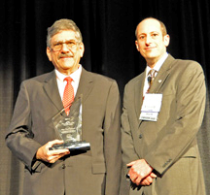

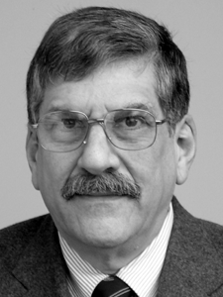
Wavefront Engineering: Levenson Phase Mask
Marc David Levenson, through the pioneering development of phase shifting masks, laid the ground-work for the industry's efforts at wavefront engineering and resolution enhancement technology.
Here he is with the Fritz Zernike Award
Marc
http://www.betasights.net/wordpress/?p=923
David

Slide 34
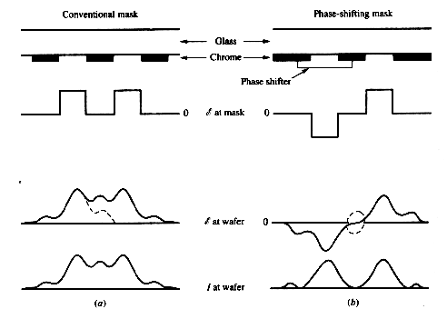
Phase Shifting Principle
Conventional Mask
Phase Shifting Mask
d
Phase Shifter
Amplitude
at Mask
d = 0.5λ/(n-1)
Amplitude
at Wafer
Intensity
at Wafer
Notes:
Shifting the phase by 180 degrees is equivalent to changing the sign of the amplitude.
The conventional binary mask only controls the magnitude of the amplitude, not its sign whereas a phase shifting mask controls both amplitude and sign. Allows for amplitudes of opposite signs on opposite sides of each narrow, opaque, mask feature.
Can use destructive interference to cancel some of the image spreading effects of diffraction.
Net result is a remarkable increase in contrast for fine dark features accompanies by a 180°phase shift – also DoF.
Exact degree depends on the degree of partial coherence For current illumination systems with σ =0.5, the DoF improvement is about 2.

Slide 35
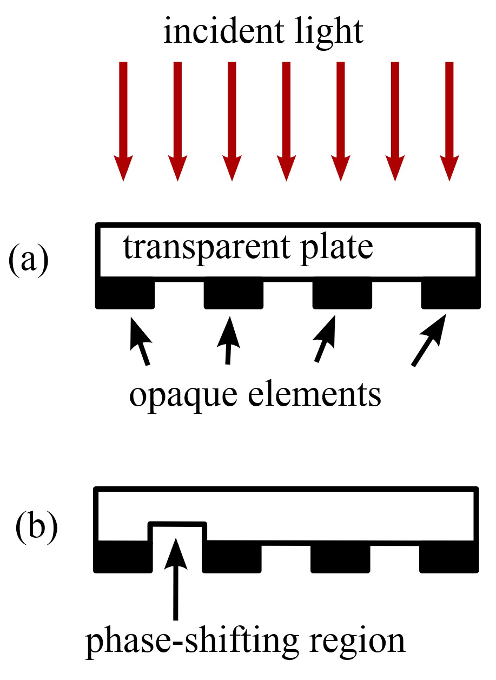
Phase Shifting Mask
https://spie.org/publications/fg06_p78-80_phase-shift_masks

Slide 36
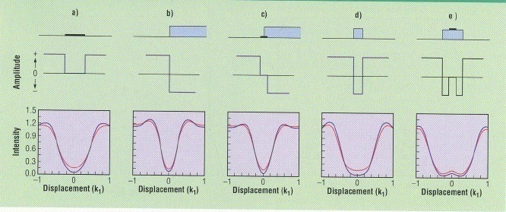
Phase Shifting Designs
M. Levenson, Microlith. World, 1(1), 6 (1992)
Five means of patterning an isolated dark line. The mask structures are shown at the top with the resulting amplitude profiles in the middle. At the bottom are the in-focus intensity profiles (and the profiles at the end of an out-of-focus k2 =1 exposure window) [red]) plotted versus displacement units of k₁. The transmission mask in (a) would print with a zero-bias width corresponding to k₁ = 0.5. The chromeless phase edge in (b) and the Levenson-mask in c (phase edge is buried under an opaque line) produce dark lines with k₁ = 0.25. The shifter-shield design in (d) projects a dark line of width k₁ = 0.6 while the rimshifter mask in (e) produces a line with k₁ = 0.8. Except for the transmission mask,in (a), each of these values is near the optimum for that mask structure.

Slide 37

Laying out Levenson Masks

Slide 38
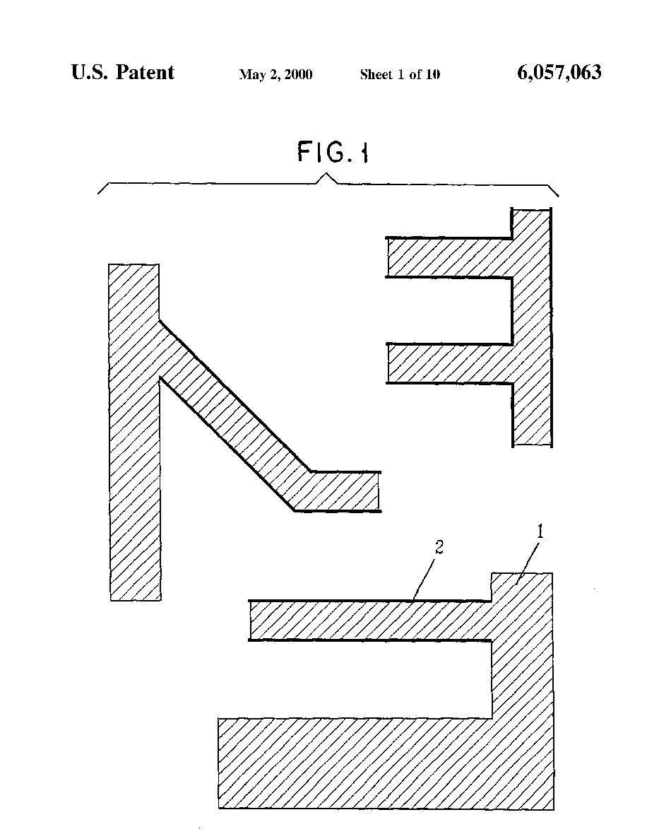
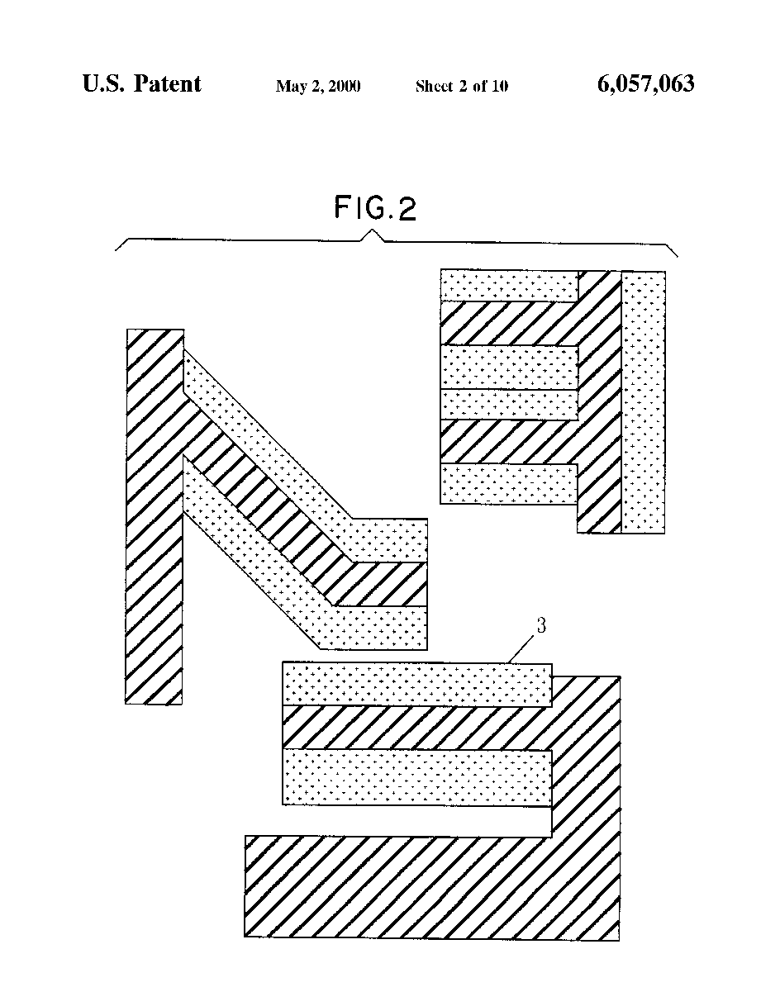
Laying out Levenson Masks

Slide 39
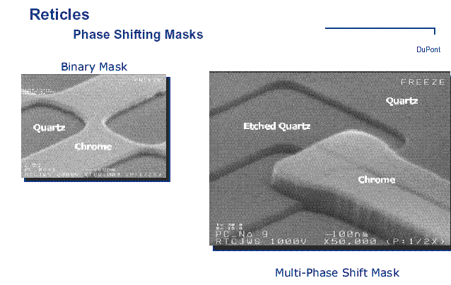

Slide 40
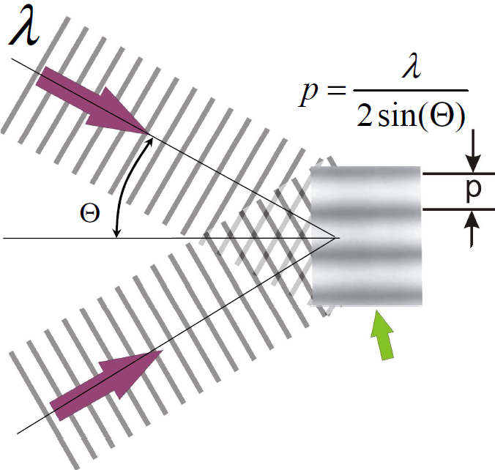
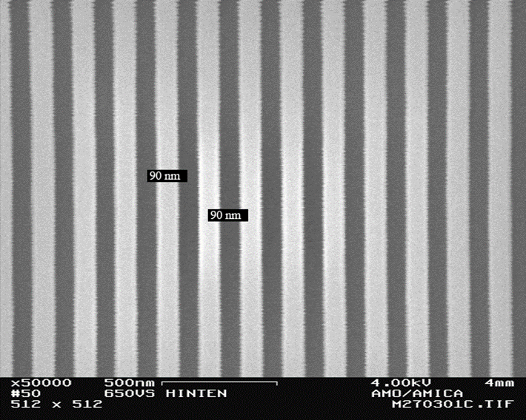
Interference lithography
Intensity modulation in the region of the overlapping of two or more coherent beams.
Two beams with same wavelength
Advantages:
Simple and fast, no photomask or lenses.
Disadvantage:
Difficult to create anything other than a periodic structure.
Requirements:
High spatial and temporal coherence of the source.
Overlapping region

Slide 41
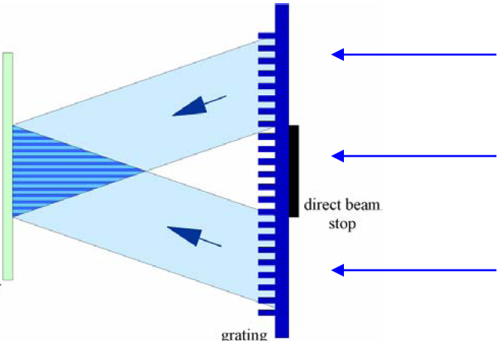
Interference lithography using incoherent light source
Wafer
Diffracted light
θ
(n is refractive index)
L₁
x
p is pitch of phase grating. P is pitch of grating on wafer.
P≡p/2, independent of λ.
(but must λ<p)
Direct-beam stop
L₂
Phase grating
For an arbitrary position X on the wafer, the two beams have the same optical path (L₁=L₂), so no need of temporal coherence (spatial coherence is still needed).
Notes:
It is not easy for the student to understand this and next slide. Need to explain well first what is spatial and temporal coherence.

Slide 42
Wavefront Engineering: Direction
Off-Axis Designs
  Annular
  Quadrupole
  Dipole
or
+
Eliminates on-axis zero order light - increases contrast
Notes:
With off-axis, illumination, the image is formed by the interference of the first-order and zero-order beams (Two Beam imaging). Both beams are subject to phase differences in a defocus position, impacting contrast.
The phase difference is given by the radial position in the in the lens pupil.
Because of the off-axis character of the illumination, this difference will be less when compared to normal on-axis illumination.
In the limiting situation, the first-order and zero-order beams have the same radial position., hence the contrast degradation in defocus will be minimal. For σ = 0, the contrast degradation will be zero.
In practical systems, the intensity distribution in the lens pupil must be radially symmetric. Deviations will result in an unwanted non telecentric system. This is the case with annular and quadrupole illumination.
Annular provides isotropic improvement in resolution. The others provide directional improvement.

